Slide 1
data science and salaries
CAPSTONE PROJECT
Presented By:
Sooraj .R
9513- Jayaraj Annapckiam CSI College of Engineering
B.E Mechanical Engineering

Slide 2
OUTLINE
Problem Statement
Proposed System/Solution
System Development Approach
Algorithm & Deployment
Result
Conclusion
Future Scope
References

Slide 3
Problem Statement
An HR analytics firm wants to analyze the factors influencing salaries in the data science field. They have collected a dataset containing information such as years of experience, level of education, programming languages known, and location of the data scientists. The goal is to build a predictive model that can accurately estimate salaries based on these factors.
The dataset includes:
Years of experience (numeric)
Level of education (categorical: Bachelor's, Master's, PhD)
Programming languages known (categorical: Python, R, SQL, Java, etc.)
Location (categorical: City A, City B, City C, etc.)
Salary (numeric)

Slide 4
Proposed Solution
Data Preprocessing:
Clean the dataset to handle missing values, outliers, and inconsistencies.
Convert categorical variables (education level, programming languages, and location) into numerical representations using techniques like one-hot encoding or label encoding.
Exploratory Data Analysis (EDA):
Conduct EDA to understand the distribution and relationships between variables.
Explore the correlation between years of experience, education level, programming languages, location, and salaries.
Visualize salary distributions across different cities and educational backgrounds.
Feature Selection:
Use techniques like correlation analysis, feature importance, or domain knowledge to select relevant features that have the most significant impact on salaries.
Model Building:
Split the dataset into training and testing sets.
Apply machine learning algorithms such as linear regression, decision trees, random forests, or gradient boosting to build a predictive model.
Use techniques like cross-validation and hyperparameter tuning to optimize the model's performance.
Model Evaluation:
Evaluate the model using metrics like Mean Squared Error (MSE), R-squared, or Mean Absolute Error (MAE) to assess its predictive accuracy.
Compare the model's performance with baseline models or industry benchmarks.

Slide 5
System Approach
Taking a systems approach to understanding data science salaries involves considering the various interconnected elements and stakeholders involved in the process. Here's how you could break it down:
System Identification Data Collection
Data Processing and Analysis
Stakeholder Analysis
Model Development
Feedback Loop
Decision Support
Continuous Improvement

Slide 6
Algorithm & Deployment
Algorithm for Predicting Data Science Salaries
Data Collection and Preprocessing:
Gather a dataset containing features such as years of experience, education level, programming languages, location, and current salaries of data scientists.
Preprocess the data by handling missing values, encoding categorical variables, and scaling numerical features if necessary.
Feature Engineering:
Create additional features if relevant, such as a combined metric for education and experience, or a skill level score based on programming languages known.
Perform feature selection to identify the most important predictors of salary.
Model Selection and Training:
Choose a regression-based model such as linear regression, decision trees, random forests, or gradient boosting.
Split the data into training and testing sets (e.g., 80% training, 20% testing).
Train the chosen model on the training data.
Model Evaluation:
Evaluate the model's performance using metrics like Mean Absolute Error (MAE), Mean Squared Error (MSE), and R-squared on the testing data.
Use cross-validation techniques to ensure the model's generalizability.

Slide 7
Deployment Process
API Development:
Develop an API endpoint that accepts input data in the required format (e.g., JSON) and processes it for prediction.
Implement error handling and validation to handle invalid or missing inputs.
Scalability and Performance:
Choose a deployment platform that can handle the expected volume of requests and provide scalability options (e.g., cloud platforms like AWS, Azure, or Google Cloud).
Optimize the model's inference time and resource utilization for efficient performance.
Monitoring and Logging:
Implement logging and monitoring mechanisms to track API usage, errors, and performance metrics (e.g., response time, throughput).
Set up alerts for abnormal behavior or performance degradation.
Security and Privacy:
Ensure data security and privacy by implementing authentication, authorization, and encryption mechanisms.
Comply with relevant regulations (e.g., GDPR, HIPAA) regarding data handling and privacy.
Integration and Maintenance:
Integrate the API with existing systems or applications where salary predictions are needed.
Plan for regular maintenance, model updates, and retraining to keep the system accurate and up to date.

Slide 8
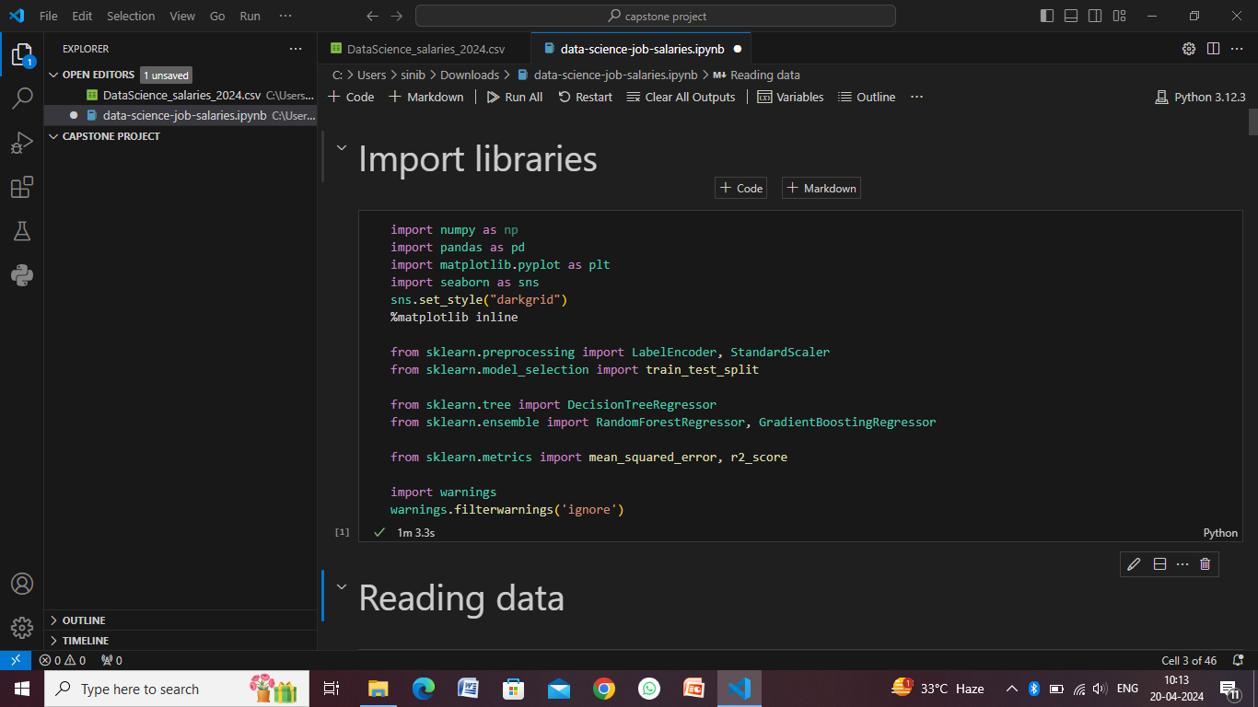
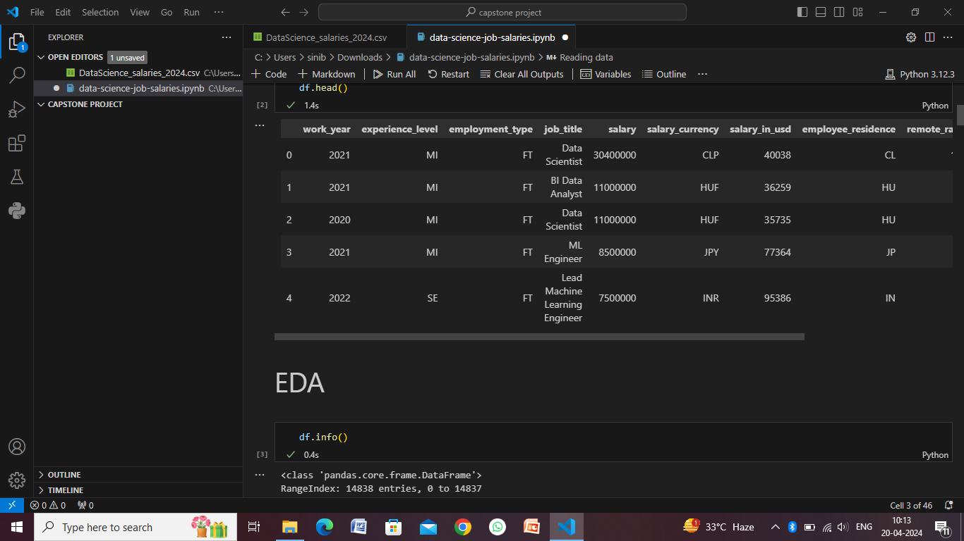
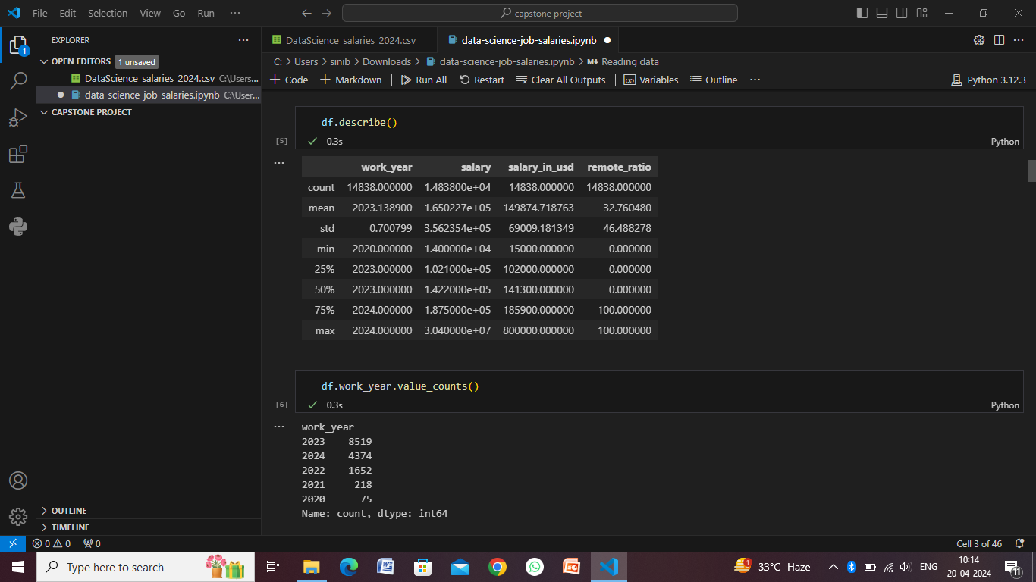
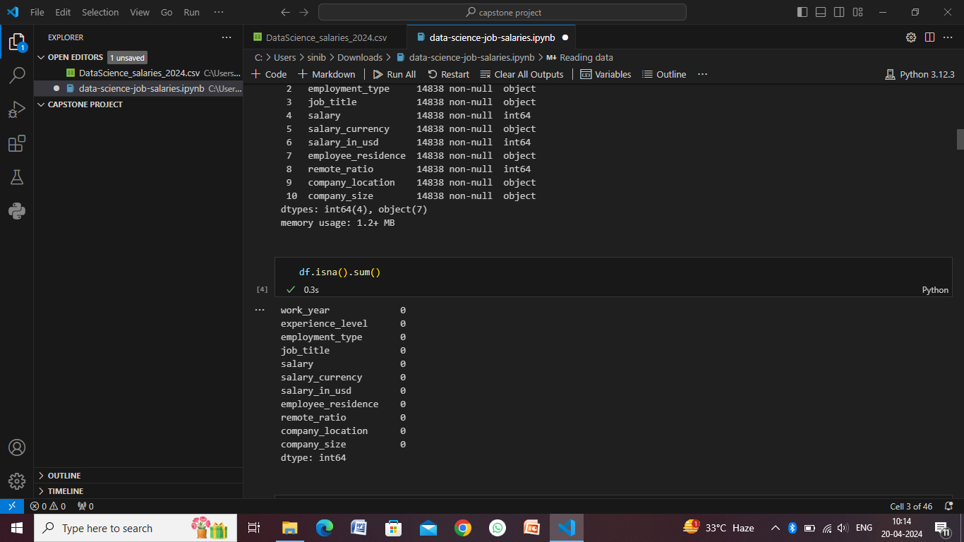
Result

Slide 9
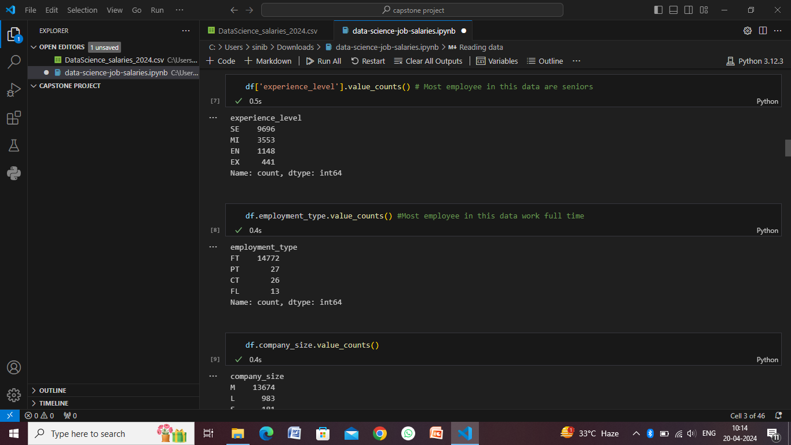
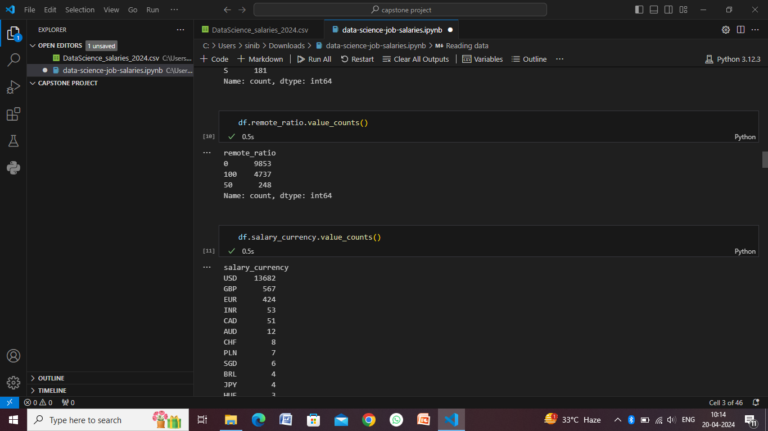
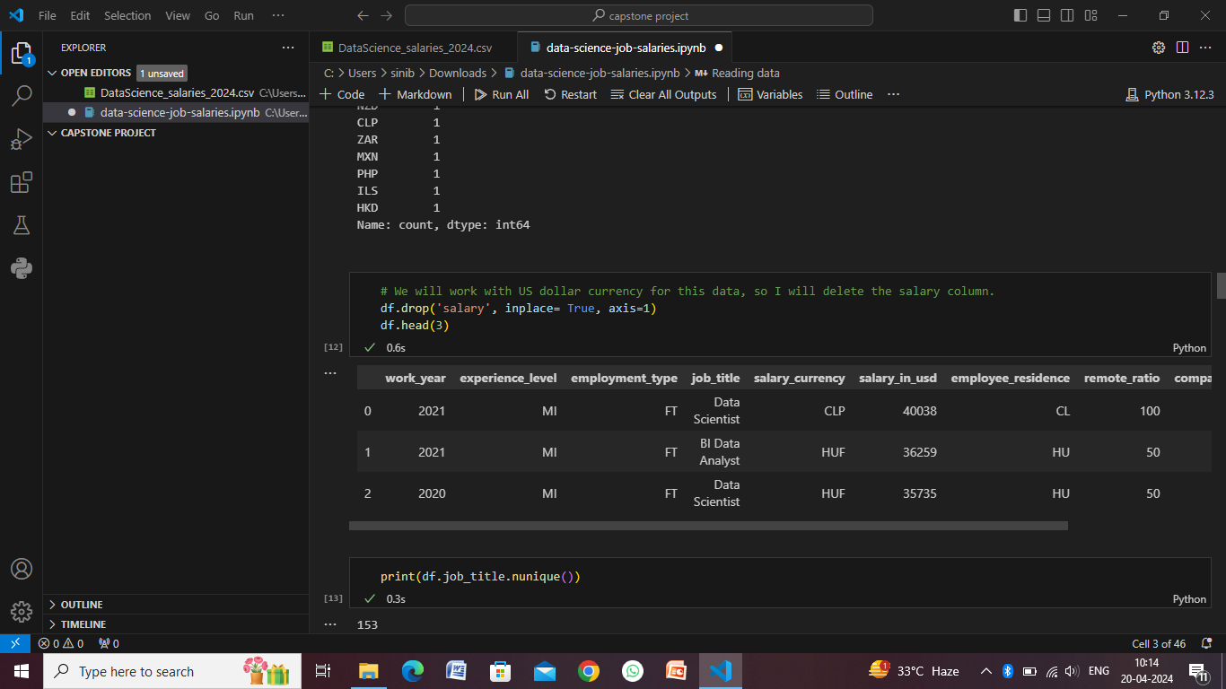
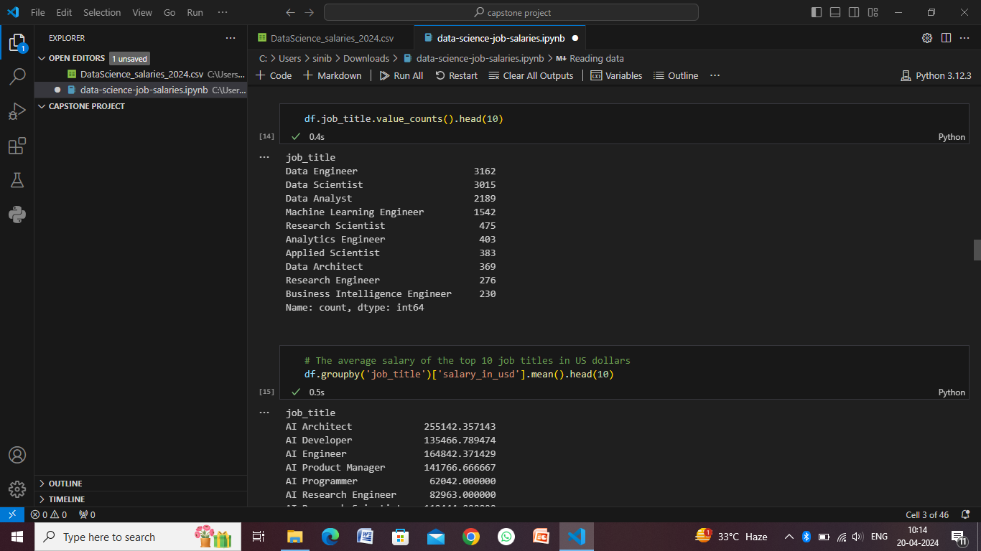

Slide 10
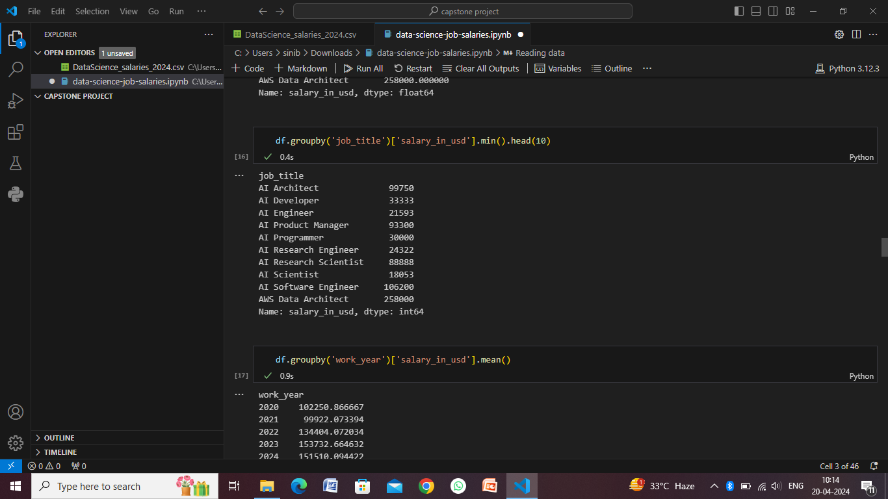
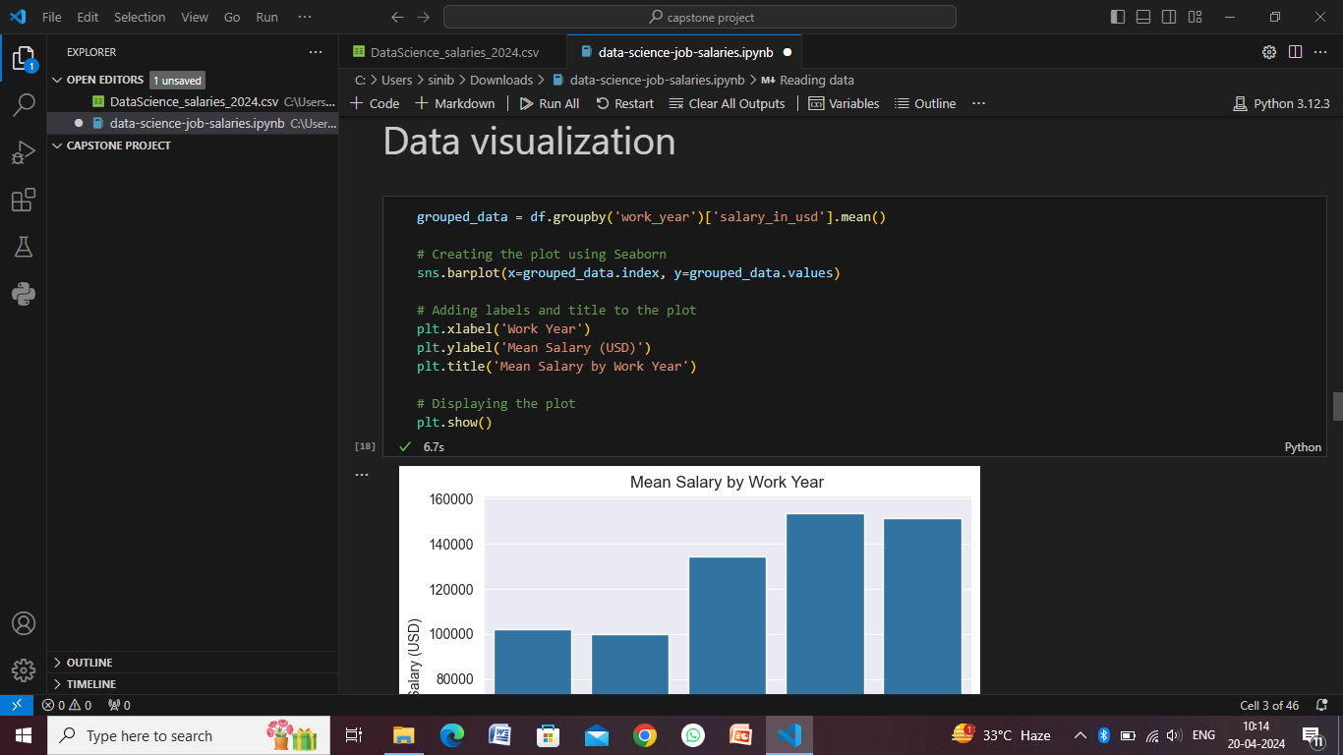
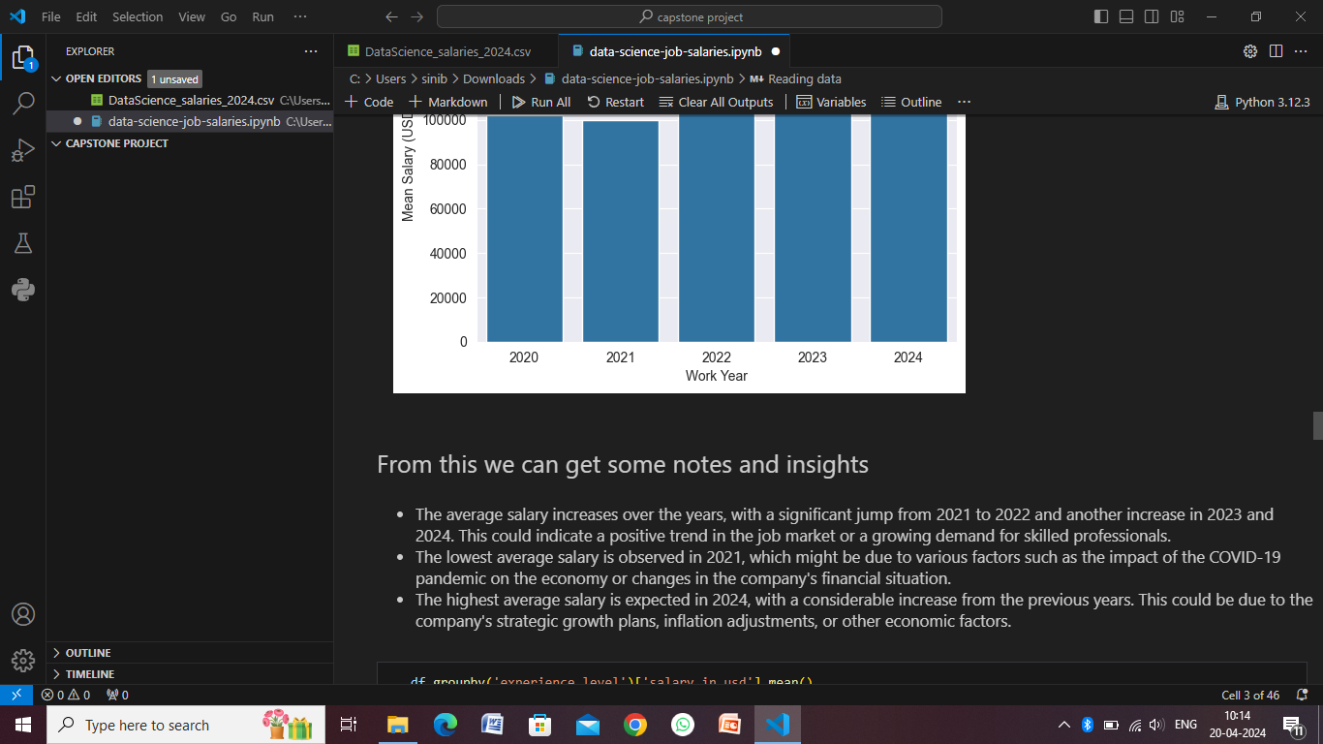
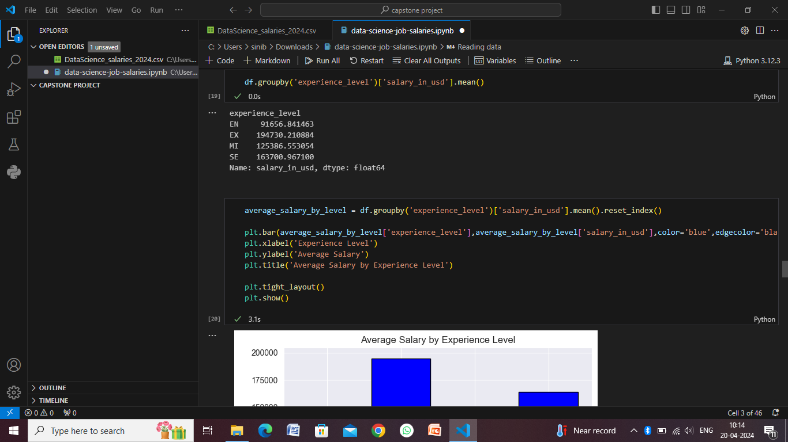

Slide 11
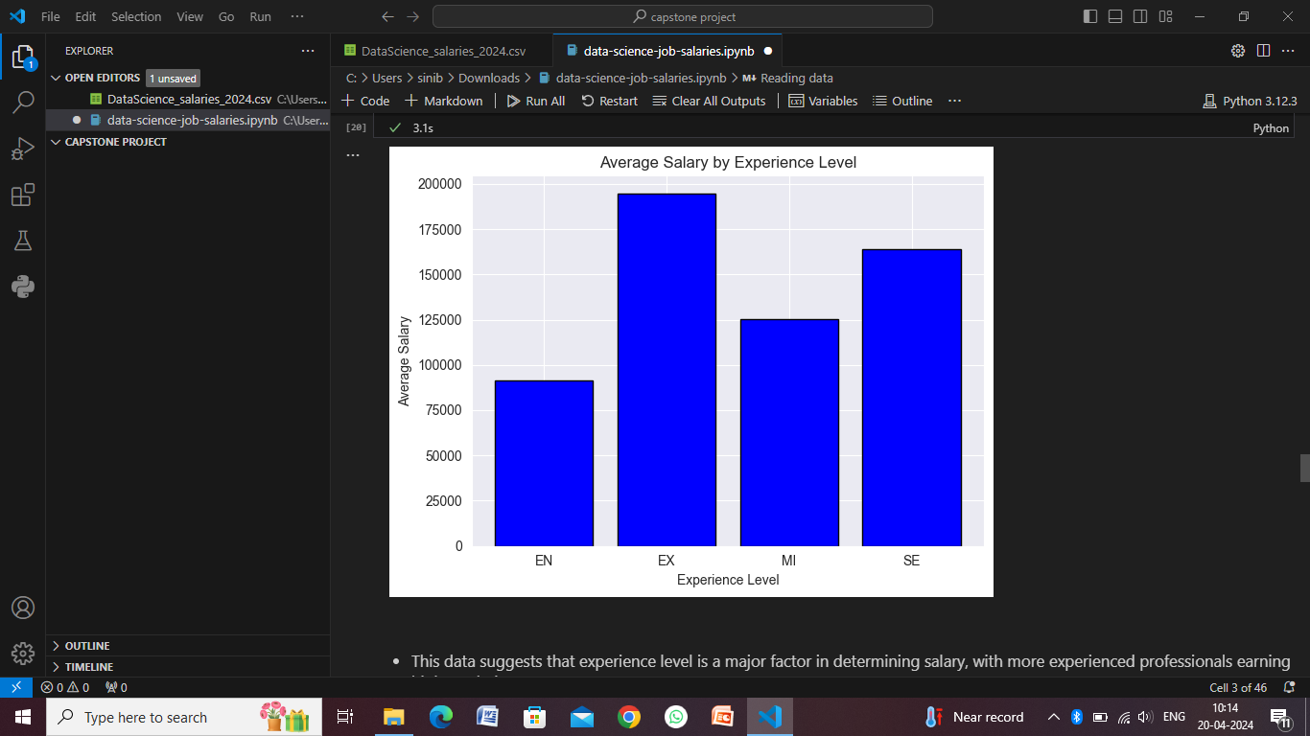
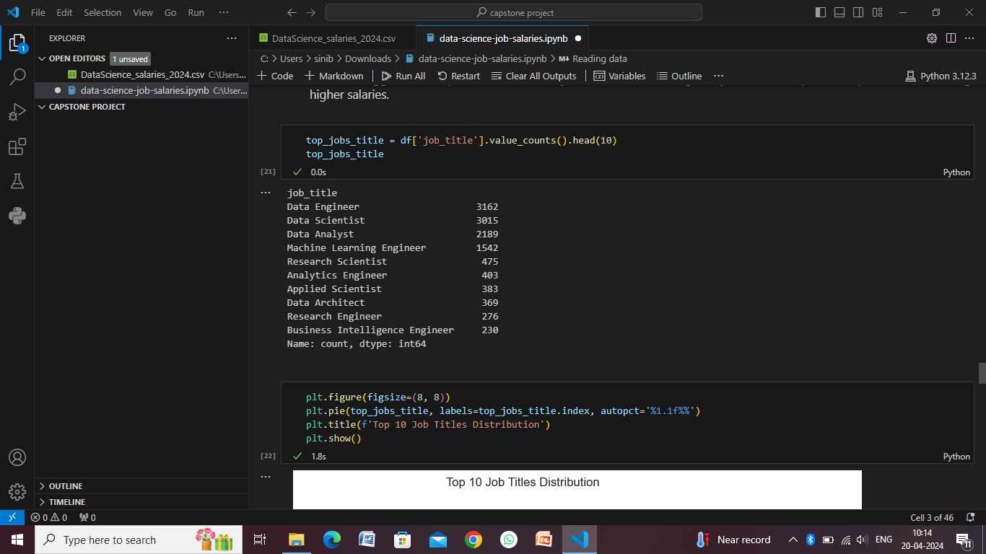
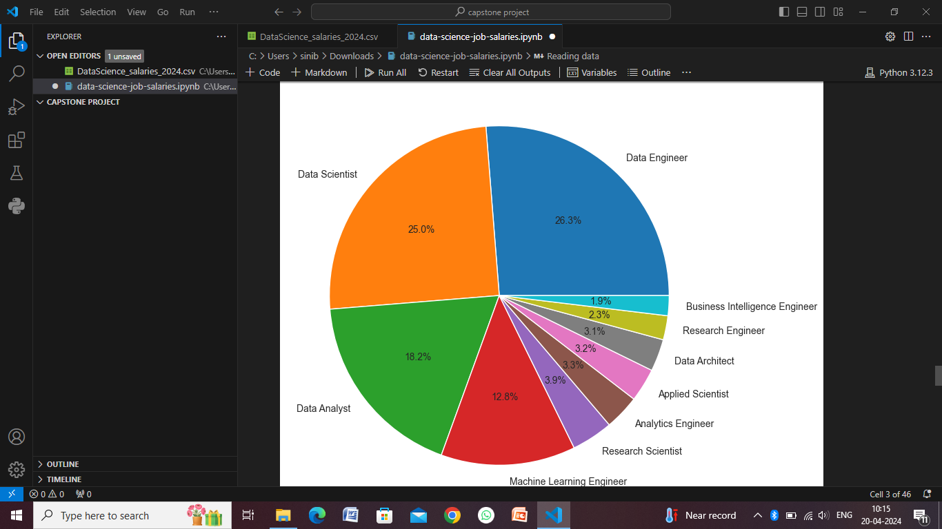
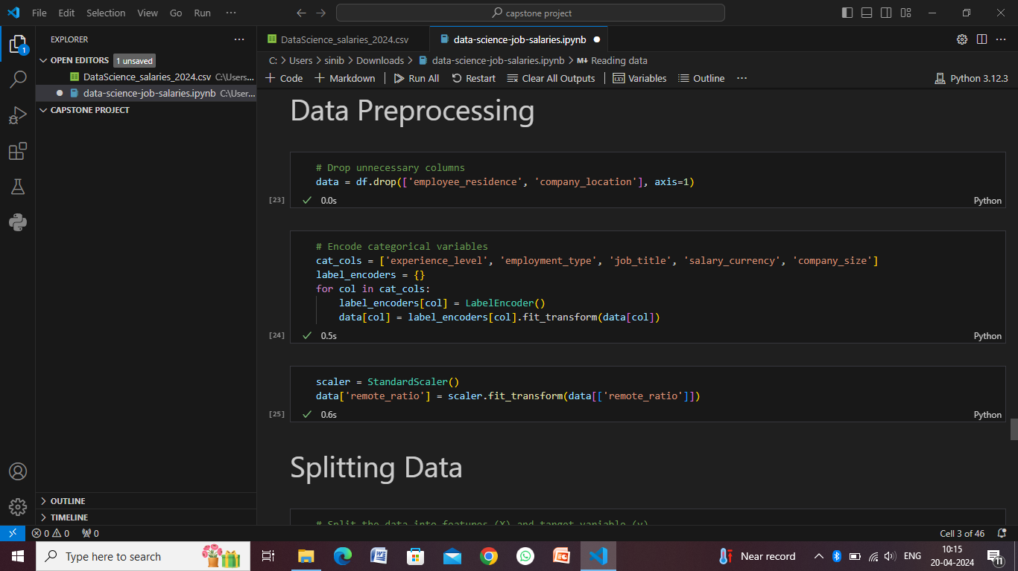

Slide 12
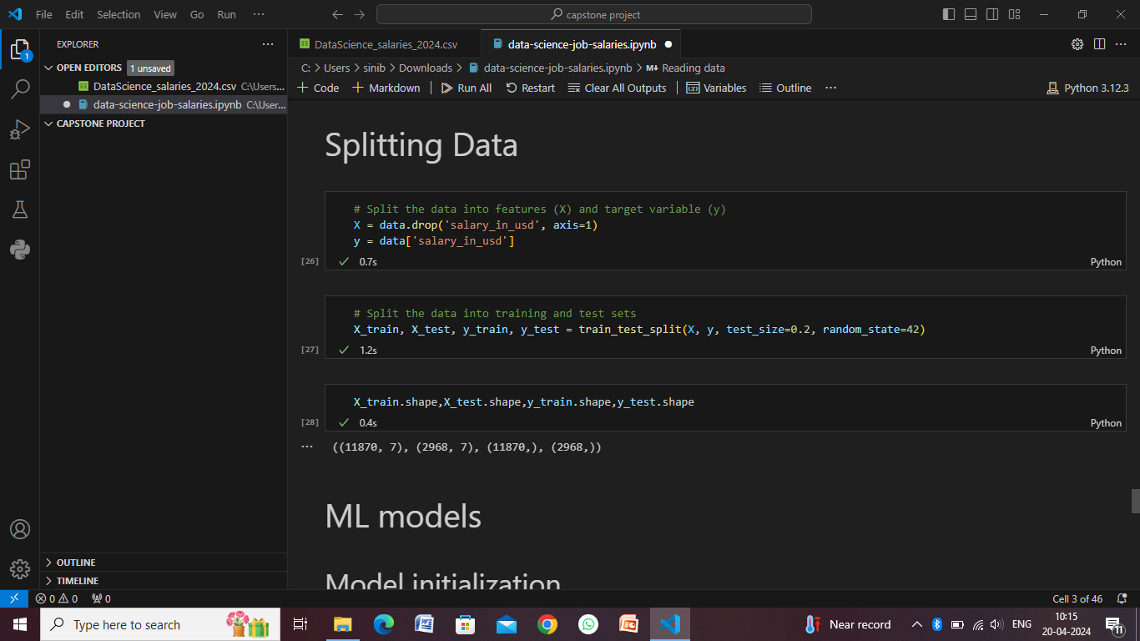
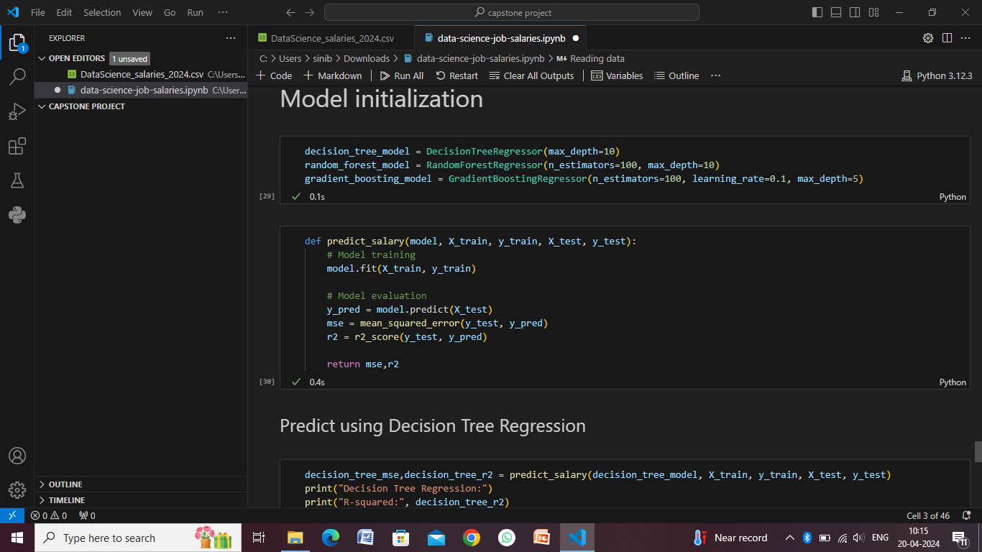
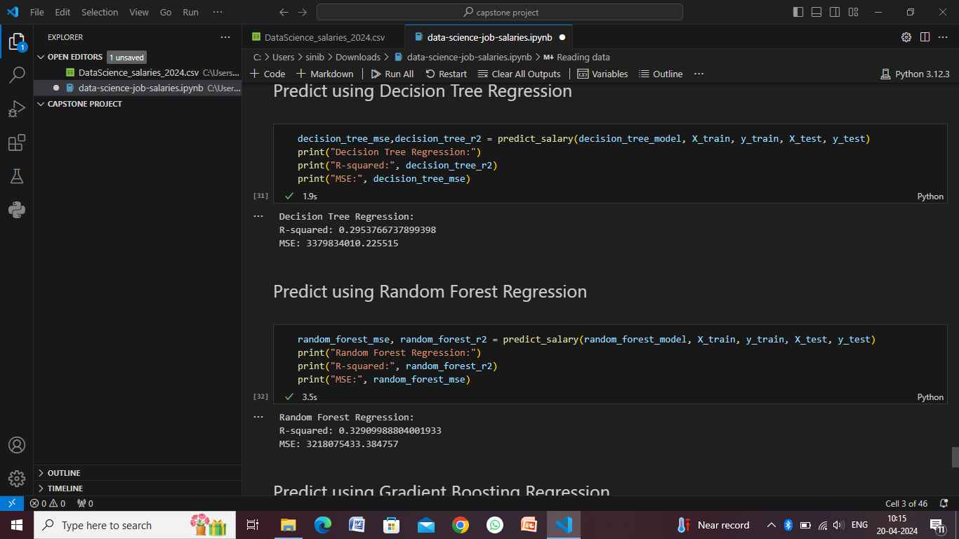
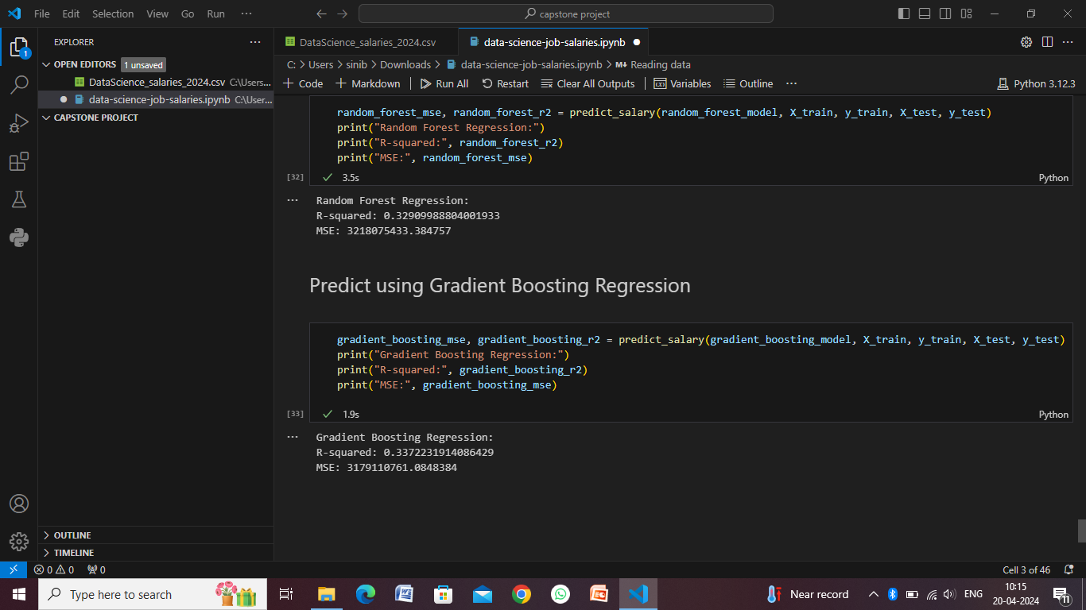

Slide 13
Conclusion
The integration of data science into salary analysis has revolutionized how organizations understand and manage compensation for data science professionals. Through advanced algorithms, machine learning models, and systematic approaches, valuable insights can be gleaned regarding the factors influencing salaries in this field.By collecting and preprocessing relevant data, including years of experience, education levels, programming language proficiencies, and geographical locations, organizations can build robust predictive models. These models not only help in estimating salaries accurately but also uncover hidden patterns and correlations among variables.The deployment of such models through APIs or integrated systems ensures that decision-makers have real-time access to salary predictions and insights. This empowers HR departments and hiring managers to make informed decisions regarding compensation packages, talent acquisition strategies, and resource allocation.Moreover, the continuous monitoring, evaluation, and refinement of these systems contribute to their effectiveness and relevance over time. Regular updates, model recalibration, and incorporating feedback from stakeholders ensure that the models remain aligned with evolving market trends and organizational goals.In essence, the synergy between data science and salary analysis enables organizations to optimize their human capital management strategies, attract top talent, and maintain competitiveness in the dynamic landscape of the data science industry.

Slide 14
Future scope
The future scope of data science in relation to salaries is expansive and promising. Here are some key areas where we can expect significant developments:
Advanced Machine Learning Models
Big Data and AI Integration
Personalized Salary Recommendations
Ethical Considerations
Predictive Analytics for Workforce Planning
Blockchain for Transparent Salary Negotiations
Global Talent Market Analysis
Continuous Learning and Adaptation

Slide 15
References
Books:
"Data Science for Business: What You Need to Know about Data Mining and Data-Analytic Thinking" by Foster Provost and Tom Fawcett.
"The Data Science Handbook" by Field Cady.
Research Papers:
"Predicting Data Scientist Salaries" by Amir Ekhlassi et al. (Available on arXiv: arxiv.org)
"Machine Learning Approaches to Predict Salaries Based on Job Descriptions" by Steven K. Sheppard et al. (Available on IEEE Xplore: ieeexplore.ieee.org)
Online Articles and Blogs:
Towards Data Science (Medium publication): towardsdatascience.com
Data Science Central: www.datasciencecentral.com
Industry Reports and Surveys:
Glassdoor Economic Research: www.glassdoor.com/research
LinkedIn Workforce Report: business.linkedin.com/talent-solutions/workforce-insights
Online Courses:
Coursera: Various courses on data science, machine learning, and HR analytics.
edX: Data science and analytics courses from universities and institutions.
Professional Organizations:
Data Science Association: www.datascienceassn.org
Society for Human Resource Management (SHRM): www.shrm.org

Slide 16
THANK YOU

